Slide 1
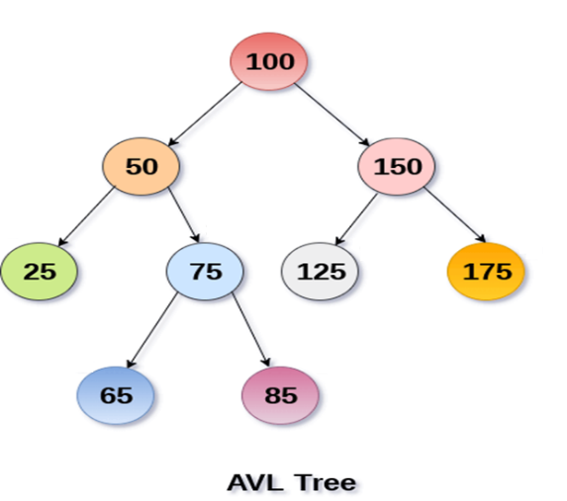
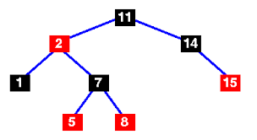
Chapter 6: Trees
Binary Trees, Binary Search Trees, Balanced trees, general trees, multi-way trees, tries, heaps

Slide 2
Learning Outcomes: Balanced Trees
AVL Trees
Red-Black Trees

Slide 3
Balanced Trees
Two popular Balanced Binary Search Tree: AVL Tree and Red-Black Tree.
Both offers O(log n) search time.
AVL Tree more suitable for search and Red-Black Tree for insertion-deletion.
Insertion-deletion takes less time in Red-Black Tree than AVL Tree.
Red-Black Tree are more popular than AVL Tree although implementing Red-Black is very complicated task.

Slide 4


Check these out!
https://www.cs.usfca.edu/~galles/visualization/AVLtree.html
AVL Tree: https://www.youtube.com/watch?v=ygZMI2YIcvk
Red-BlackTree: https://www.youtube.com/watch?v=YCo2-H2CL6Q&list=PLqM7alHXFySHCXD7r1J0ky9Zg_GBB1dbk&index=5

Slide 5
AVL Trees - Tree Balancing.
Self-adjusting, height-balanced binary search trees
Named after the inventors: Adelson-Velskii and Landis.
With binary trees the order in which items are inserted into the tree determines the shape of the tree and how efficiently this tree can be searched.
eg. N, I, G, R, M, P, D, V, T, O, W
N
I
R
G
M
P
V
D
O
T
W

Slide 6
AVL trees
If inserted in the order, D, G, I, M, N, O, P, R, T, V, W
D
G
I
M

Slide 7
AVL trees
Tree Balancing is a technique for keeping a binary search tree balanced as items are inserted into it.
In a binary tree, the balance factor of a node x is defined as the height of it's left tree minus the height of it's right tree.
A binary tree is said to be an AVL or height balanced tree, if the balance factor of each node is either 1, 0, or -1.

Slide 8
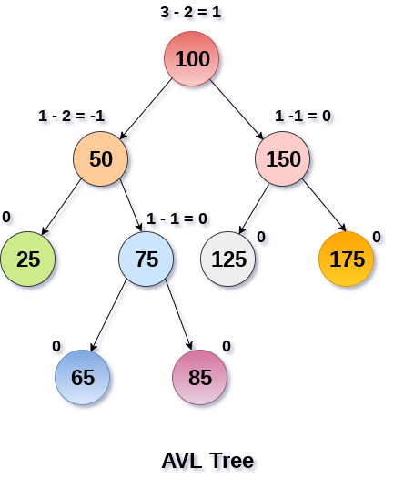
Calculating balance factors
https://www.javatpoint.com/avl-tree

Slide 9
AVL trees
Some AVL trees
0
+1
-1
0
0
+1
0
+1
0
0
0
+1
+1
0
0

Slide 10
AVL trees
The following are not AVL trees.

Slide 11
AVL trees
Example :Constructing an AVL tree : inserting nodes
order : R, P, D, G, O, K, H, M, J, V
Reference:
http://www.site.uottawa.ca/~stan/csi2514/applets/avl/BT.html
from site

Slide 12
Insert R, P, D
+2
R
P
+1
P
D
R
0
D
Right Rotate at R
Q?: Where was D inserted in relation to where the imbalance occurred?

Slide 13
Insert G, O
+1
P
P
D
R
0
G
R
-2
-1
G
D
O
0
O
Left Rotate at D
Q?: Where was O inserted in relation to where the imbalance occurred?

Slide 14
Insert K
P
P
O
R
O
R
G
P
G
G
O
D
K
R
D
D
K
Right rotate at P
K
Left at left child
Left-Right Rotate at P
Q?: Where was K inserted in relation to where the imbalance occurred?

Slide 15
Insert H, M, J
O
O
O
G
P
G
P
H
P
D
K
R
D
H
R
G
K
R
H
M
K
D
J
M
J
J
M
Left rotate at G
Right-Left Rotate at G
Right Rotate at right child

Slide 16
Insert V
O
H
P
G
K
R
D
J
M
V
Requires ?? Rotate at ??

Slide 17
AVL trees
As this example demonstrates, when a new item is inserted into a balanced binary tree, the resulting tree may be unbalanced.
It also demonstrates that the tree can be rebalanced by transforming the subtree rooted at the node that is the nearest ancestor of the new node having balance factor +2 or -2.

Slide 18
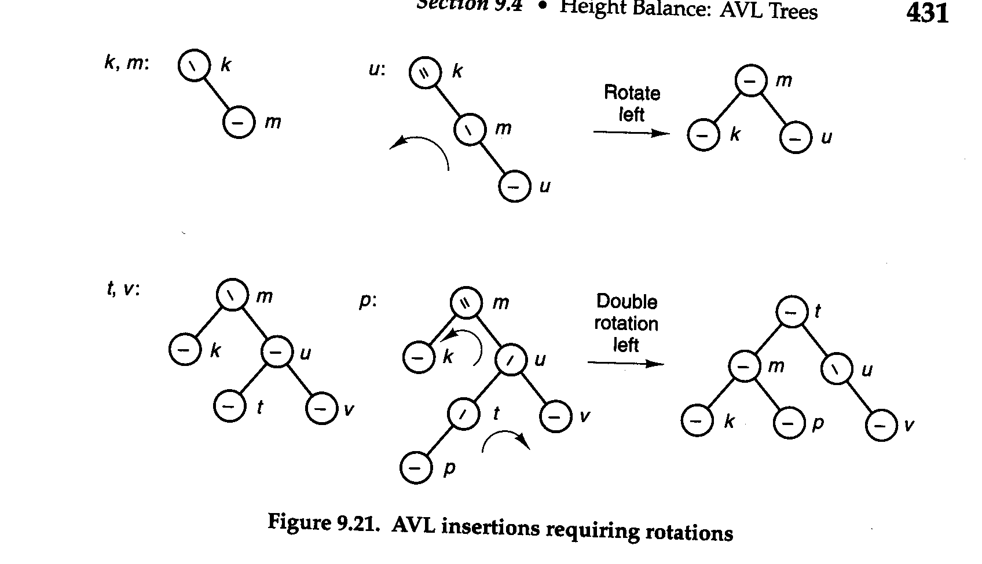
AVL trees

Slide 19
AVL trees
This transformation can be carried out using one of the following 4 types of rotations :
Simple right rotation : This rotation is used when the new item is in the left sub-tree of the left child B of the nearest ancestor A with a balance factor +2 .
2. Simple left rotation : This rotation is used when the new item is in the right sub-tree of the right child B of the nearest ancestor A with a balance factor -2 .

Slide 20
AVL trees
Left-right rotation : this is used when the new item is in the right sub-tree of the left child B of the nearest ancestor A with a balance factor +2 .
4. Right-left rotation : this is used when the new item is in the left sub-tree of the right child B of the nearest ancestor A with a balance factor -2 .

Slide 21
AVL trees
ALGORITHMS
Each of these rotations can be carried out by simply resetting some of the links.
Left rotation : used when the new item is in the right sub-tree of the right child B of the nearest ancestor A with a balance factor -2.

Slide 22
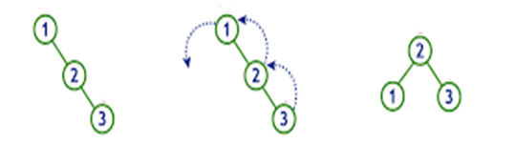
AVL trees
This rotation can be accomplished by resetting 3 links :
leftrotation(root)
q = root->right
hold=q->left
q->left = root
root->right = hold
Exercise : Write the algorithm for a right rotation.
root: where imbalance occurred
root

Slide 23
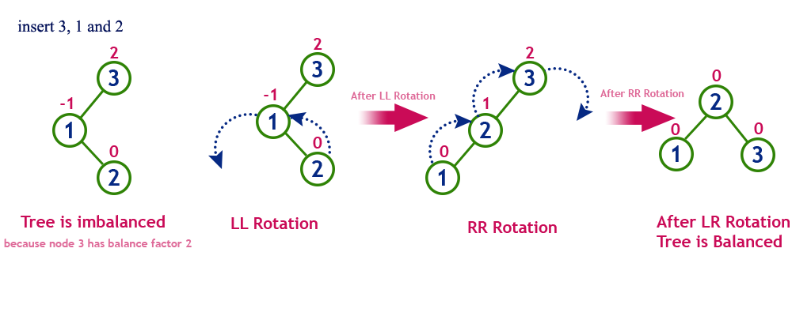
AVL trees
Left-right rotation : used when the new item is in the right sub-tree of the left child B of the nearest ancestor A with a balance factor +2 .
The left rotation-left child followed by a right rotation at root:

Slide 24
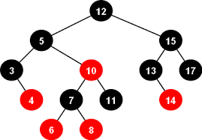
Red Black Trees

Slide 25
Check this out!
Red Black Animation
slightly different colouring algorithm than one used here in slides
https://www.cs.usfca.edu/~galles/visualization/RedBlack.html

Slide 26
Red-Black Trees
A red-black tree (RBT) is a binary search tree that satisfies the following red-black properties:
1. Every node has a color that is either red or black.
2. The root of the tree is black
3. If a node is red, both children are black.
4. Every path from a given node down to any descendant leaf contains the same number of black nodes.
The number of black nodes on such a path (not including the initial node but including leaves) is called the black-height (bh) of the node.
http://cs.wellesley.edu/~cs231/fall01/red-black.pdf

Slide 27
Example of a Red Black Tree
19
12
35
3
16
21
56
30

Slide 28
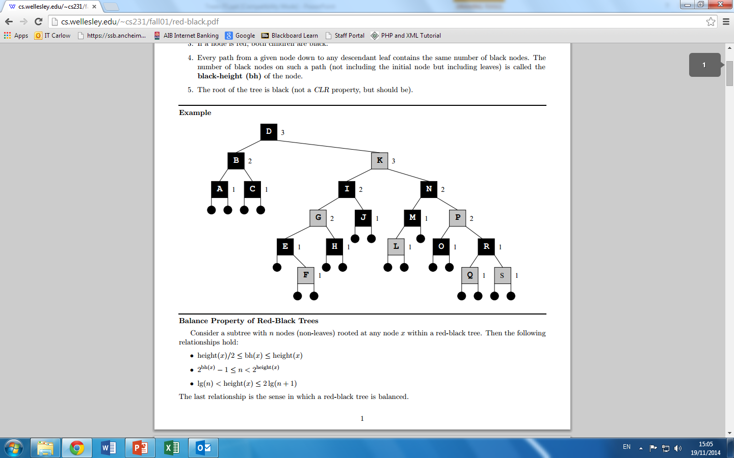
K
G
P
L
F
Q
S

Slide 29
Applications of RBTs
The process scheduler in Linux uses Red-Black Trees. The red black trees are a replacement for run queues which had priorities for processes on the queue for the scheduler to pick up from. (Completely Fair Scheduler)
The TreeMap class in Java is implemented using RBT structure. A TreeMap provides an efficient means of storing key/value pairs in sorted order, and allows rapid retrieval.

Slide 30

Applications of RBTs

Slide 31
Red Black Tree?
19
12
35
3
16
0

Slide 32
Insertion into RB Tree
A red-black tree (RBT) is a binary search tree that satisfies the following red-black properties:
1. Every node has a color that is either red or black.
2. The root of the tree is black
3. If a node is red, both children are black.
4. Every path from a given node down to any descendant leaf contains the same number of black nodes.
Use usual BST insertion algorithm, colouring new node red.
RBT property 3 will not hold if there is red-red violation
Remove red-red violation by rotations. (Note: it may be necessary to apply rules multiple times)
If Step 1 or 2 leaves the root red, then blacken the root.

Slide 33
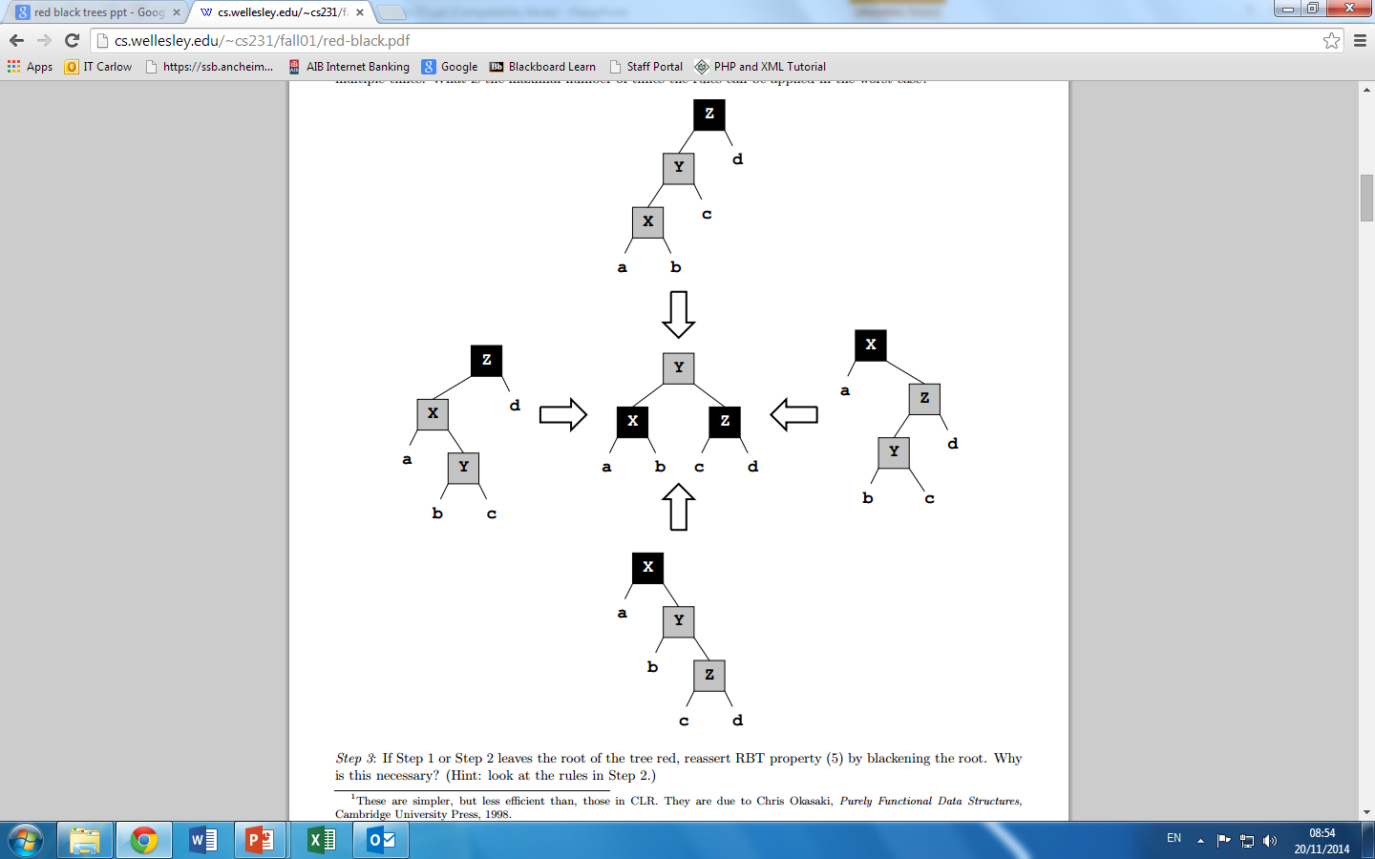
RBT Rotations
Y
X
Y
X
Z
Y
Y
Y
Z

Slide 34
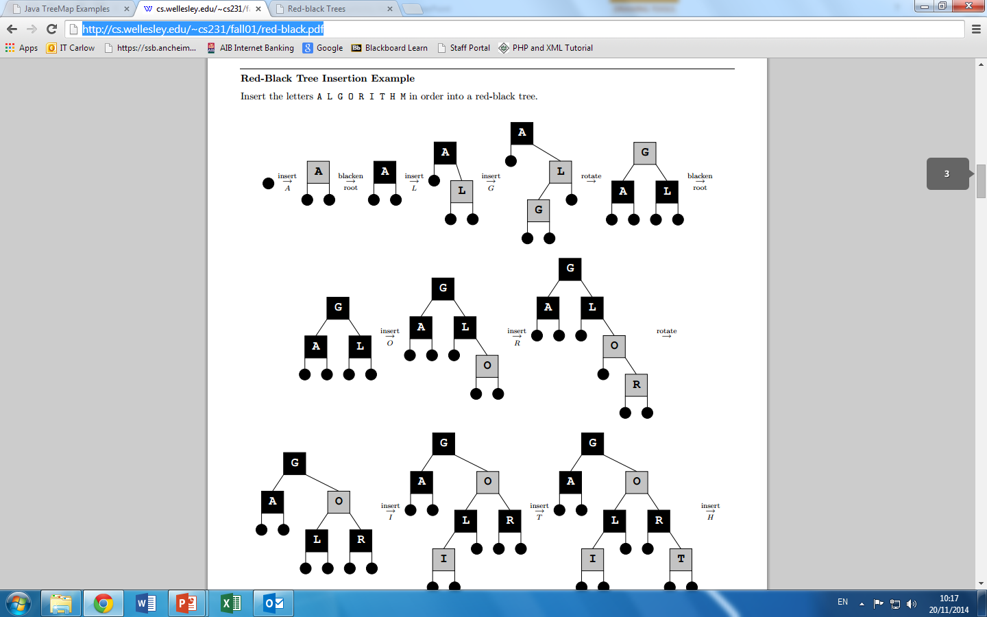
Example
Ref: https://sethfurman.github.io/programming/c/2017/05/13/red-black-tree-c.html

Slide 35
Example of Inserting Sorted Numbers
Insert 1 2 3 4 5 6 7 8 9 10
Insert 1.
A leaf so red. Realize it is root so recolor to black.
1
1

Slide 36
Insert 2
1
Make 2 red.
Parent is black so done.
2
Insert 3
1
2
Insert 3. Red-Red Rule violation.
Left Rotation needed
2 is root so need to blacken it
3
2
2
1
3
1
3

Slide 37
Insert 4
2
When adding 4 parent is black so done.
1
3
4
Insert 5
2
2
1
3
1
4
4
RBT ?
3
5
No! Requires ?.....
5

Slide 38
Insert 6
2
1
4
6's parent is black so done.
3
5
6
Insert 7
2
1
4
3
5
RBT ?
6
No! Requires ?.....
7

Slide 39
Insert 7
4
2
2
6
1
4
1
3
5
7
3
6
RBT yet?
No! Requires ?.....
5
7
4
RBT yet?
No! Requires ?.....
2
6
1
3
5
7

Slide 40
Insert 8
4
Insert 9
2
6
1
3
5
7
4
8
2
6
1
3
5
8
After rotations and recoloring
7
9

Slide 41
Insert 10
4
2
6
1
3
5
8
7
9
10

Slide 42
In Summary!
Differences:
AVL trees provide faster lookups than Red Black Trees because they are more strictly balanced.
Red Black Trees provide faster insertion and removal operations than AVL trees as fewer rotations are done due to relatively relaxed balancing.
Red Black Trees are used in most of the language libraries like map, multimap, multisettin C++ whereas AVL trees are used in databases where faster retrievals are required.
https://www.geeksforgeeks.org/red-black-tree-vs-avl-tree/

Slide 43
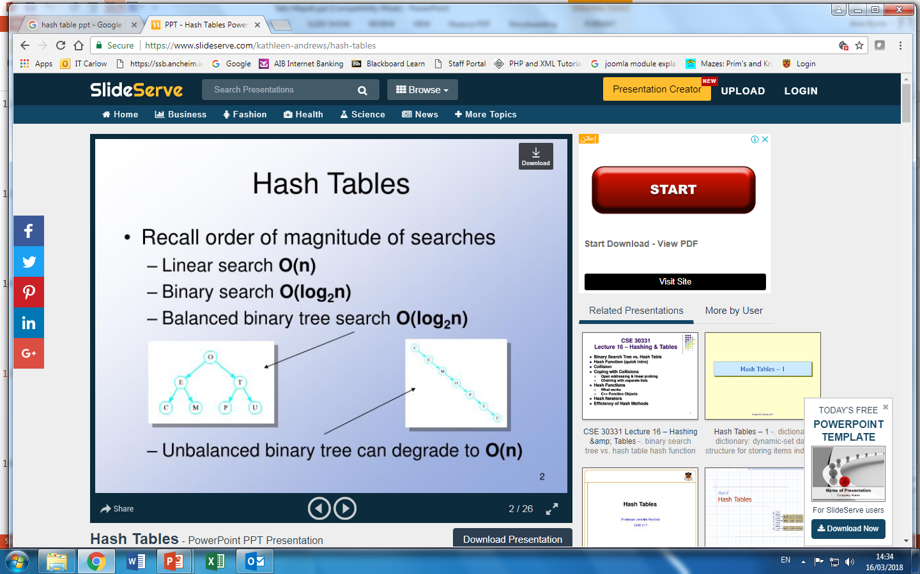
In Summary! Big O of Searches

